Slide 1




Slide 2

Relation between
SI & CI

Slide 3
Test time on :
QR CODE:

Slide 4
Relation Between SI & CI
There are two ways to calculate interest on a loan. Simple interest is easier to calculate than compound interest due to some fundamental relation between the two. The following example will tell us the relation between simple and compound interest.

Slide 5
Question: 01
Let us say Rimi has borrowed (principal) ₹100 at 5% per annum for 33 years at simple interest. How much will she pay if she pays the final amount of 1st year/ 2nd year /
3rd year?
A. ₹115
B. ₹100
C. ₹105
D. ₹110
Answer: A

Slide 6
Explanation: 01
For 1st 1st year the principal amount is P=₹100 Simple Interest=₹5 Amount =₹100+₹5 =₹105 For 2nd year the principal amount is P=₹100 Simple Interest=₹100×5×1/100 =₹5 Amount =₹105+₹5 =₹110 For 3rd year the principal amount is P=₹100 Simple Interest=₹100×5×1/100 =₹5 Amount =₹110+₹5 =₹115

Slide 7
Question: 02
If the simple interest on a sum of money for 2 years at 5% per annum is Rs. 50, what is the compound interest on the same at the same rate and for the same time?
A. Rs. 51.25
B. Rs. 52
C. Rs. 54.25
D. Rs. 60
Answer: A

Slide 8
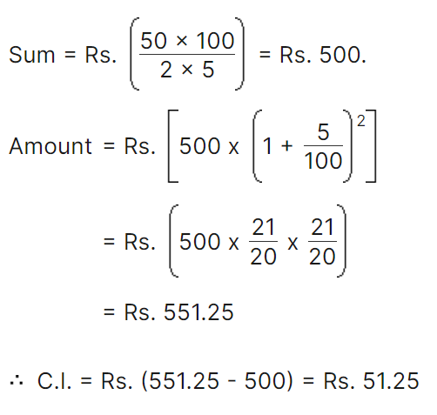
Explanation: 02

Slide 9
Question: 03
Calculate the compound interest at the rate of 6% per annum for 2 years on the principle which in 2 years at the rate of 2% per annum gives Rs. 8000 as simple interest.
A. 50000
B. 49440
C. 59440
D. 49000
Answer: B

Slide 10
Explanation: 03
P = 8000 × 1002 × 2 = 400000 A = 400000(1 + 6100)2 = 400000 (5350)2 = Rs. 449440 C.I. = 449440 – 400000 = Rs. 49440.

Slide 11
Question: 04
Compute the compound interest on Rs. 16000 for 2 years 10% per annum when compounded half yearly.
A. 18600
B. 17640
C. 18640
D. 17600
Answer: B

Slide 12

Explanation: 04

Slide 13
Question: 05
Ravi took a loan of Rs. 1200 with simple interest for as many years as the rate of interest. If she paid Rs. 432 as interest at the end of the loan period, what was the rate of interest ?
A. 3.6
B. 6
C. 18
D. 17
Answer: B

Slide 14
Explanation: 05
Let rate = R% and time = R years.
Then, (1200 × R × R)/100 = 432
=> 12R² = 432
=> R² = 36
=> R = 6.

Slide 15
Question: 06
A sum of Rs. 725 is lent in the beginning of a year at a certain rate of interest. After 8 months, a sum of Rs. 362.50 more is lent but at the rate twice the former. At the end of the year, Rs. 33.50 is earned as interest from both the loans. What was the original rate of interest?
3.6%
4.5%
5%
None of these
Answer: D

Slide 16
Explanation: 06
Let the original rate be R%. Then, new rate = (2R)%.
Here, original rate is for 1 year(s); the new rate is for only 4 months i.e. for 1/3 year.
∴ [(725 × R × 1)/100] + [362.50 × 2R × 1)/(100 × 3)] = 33.50
=> (2175 + 725) R = 33.50 × 100 × 3
=> (2175 + 725) R = 10050
=> (2900) R = 10050
=> R = (10050/2900) = 3.46
∴ Original rate = 3.46%

Slide 17
Question: 07
Simple interest on a certain sum of money for 3 years at 8% per annum is half the compound interest on Rs. 4000 for 2 years at 10% per annum. The sum placed on simple interest is:
A. Rs. 1550
B. Rs. 1650
C. Rs. 1750
D. Rs. 2000
Answer: C

Slide 18
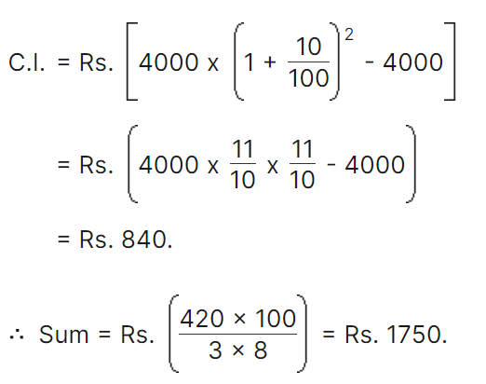
Explanation: 07

Slide 19
Question: 08
The difference between simple interest and compound on Rs. 1200 for one year at 10% per annum reckoned half-yearly is:
Rs.2.50
Rs.3
Rs.3.75
Rs.4
Answer: b

Slide 20
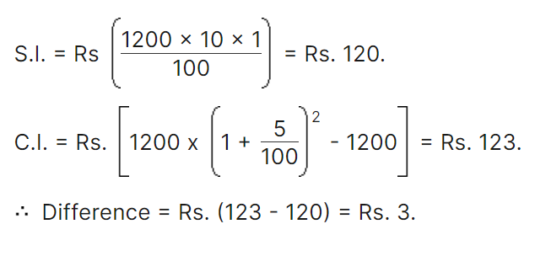
Explanation: 08

Slide 21
Question: 09
The difference between compound interest and simple interest on an amount of Rs. 15,000 for 2 years is Rs. 96. What is the rate of interest per annum?
8
10
12
Cannot be determined
Answer: A

Slide 22
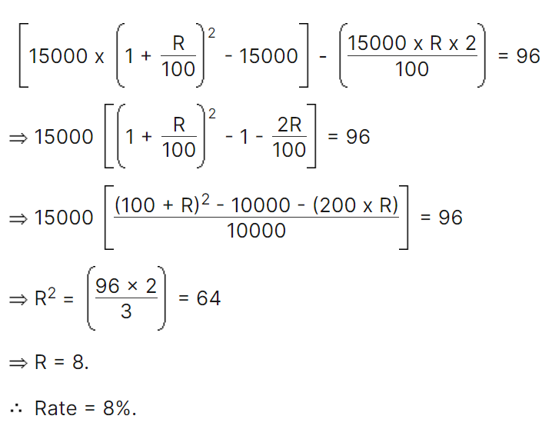
Explanation: 09

Slide 23
Question: 10
The compound interest on a certain sum for 2 years at 10% per annum is Rs. 525. The simple interest on the same sum for double the time at half the rate percent per annum is:
Rs.400
Rs.500
Rs.600
Rs.800
Answer: B

Slide 24
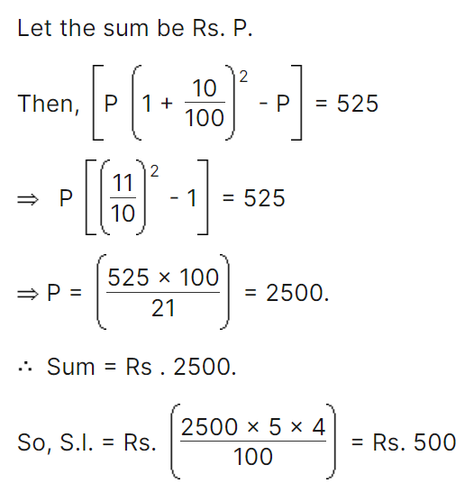
Explanation: 10

Slide 25
Question: 11
The effective annual rate of interest corresponding to a nominal rate of 6% per annum payable half-yearly is:
6.06%
6.07%
6.08%
6.09%
Answer:D

Slide 26
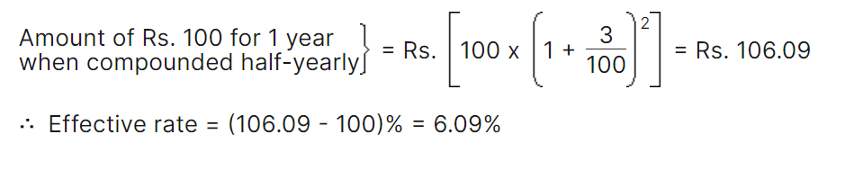
Explanation: 11

Slide 27
Question: 12
Albert invested an amount of Rs. 8000 in a fixed deposit scheme for 2 years at compound interest rate 5 p.c. How much amount will Albert get on maturity of the fixed deposit?
A. Rs. 8600
B. Rs. 8620
C. Rs. 8820
D. None of these
Answer: C

Slide 28
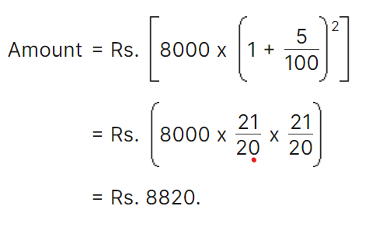
Explanation: 12

Slide 29
Question: 13
The least number of complete years in which a sum of money put out at 20% compound interest will be more than doubled is:
3
4
5
6
Answer: C

Slide 30
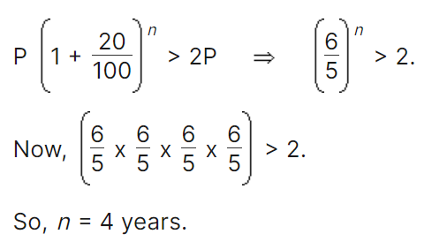
Explanation: 13

Slide 31
Question: 14
Calculate the compound interest on Rs. 4000 for 2 years at 20% per annum when compounded annually.
1856.4
1756.4
1846.4
1746.4
Answer: A

Slide 32
Explanation: 14
A = P (1 + R/200)2n = 4000(11/10)^4
= Rs. 5856.4
C.I. = 5856.4 – 4000 = Rs. 1856.4

Slide 33
Question: 15
Find the amount on Rs. 5000 at the rate of 20% per annum for 18 months when interest is compounded half yearly.
6644
6666
6000
6655
Answer: D

Slide 34
Explanation: 15
n = 18/12 = 3/2
A = P (1 + R200)2n
= 5000 (1 + 20200)2n = Rs. 6655.

Slide 35

https://learn.codemithra.com

Slide 36




THANK YOU
+91 78150 95095
codemithra@ethnus.com
www.codemithra.com

